Slide 1
Network Term project
한다혜 유수화 유가은
Network
PPT
HuU

Slide 2

Index
The title
Term project final presentation
Key features & Contents
Software tool
Used technology for implementation
Hardship
Final progress
Demo video
Review
Roles of each member
member Information

Slide 3

Title
TO OVERCOME
유수화 유가은 한다혜 (HuU)

Slide 4

Key feature
To overcome the indecisiveness!
If user choose the kind of food and choose the priority
between price order, distance order and recommendation order, with the recommendation of the food and restaurant information being recommended. So, user can be overcome the indecisiveness.
To overcome the eat alone people!
Random chatting room is created by selecting the eat alone icon.
Eat alone people can make appointment with other people in the chatting room.
So, eat alone people can be overcome.

Slide 5
Contents in details
1. By giving the user a check box for type of food, select the type of food in the check box.
2. Choose the priority between price order, distance and recommendation
from the type of food chosen above, and recommend the food.
3. The recommended food is random from the chosen category.
4. Describe the details of the location where you can eat of restaurant, price, location,
phone number with the recommended food.
5. Click the eat alone icon, random chatting room is created with another eat alone people.

Slide 6


Software Tool
GitHub

Slide 7



Used technology
for implementation
JAVA
DataBase
Java swing(UI)
Thread
Socket Programming

Slide 8
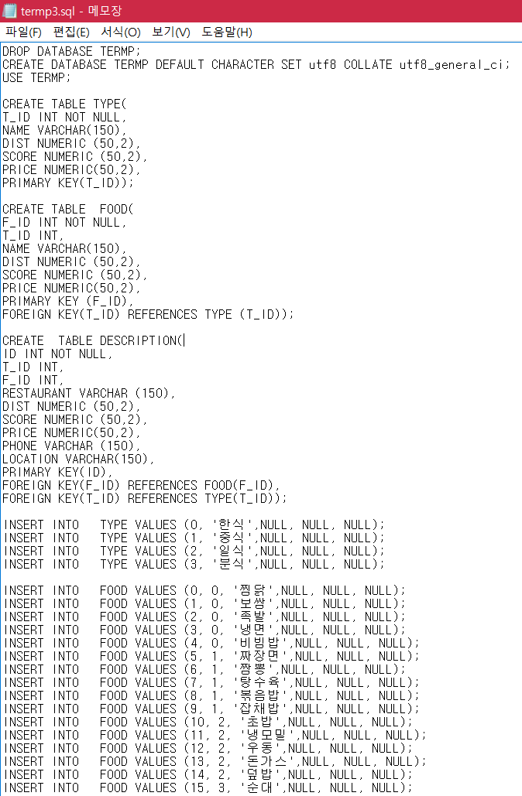
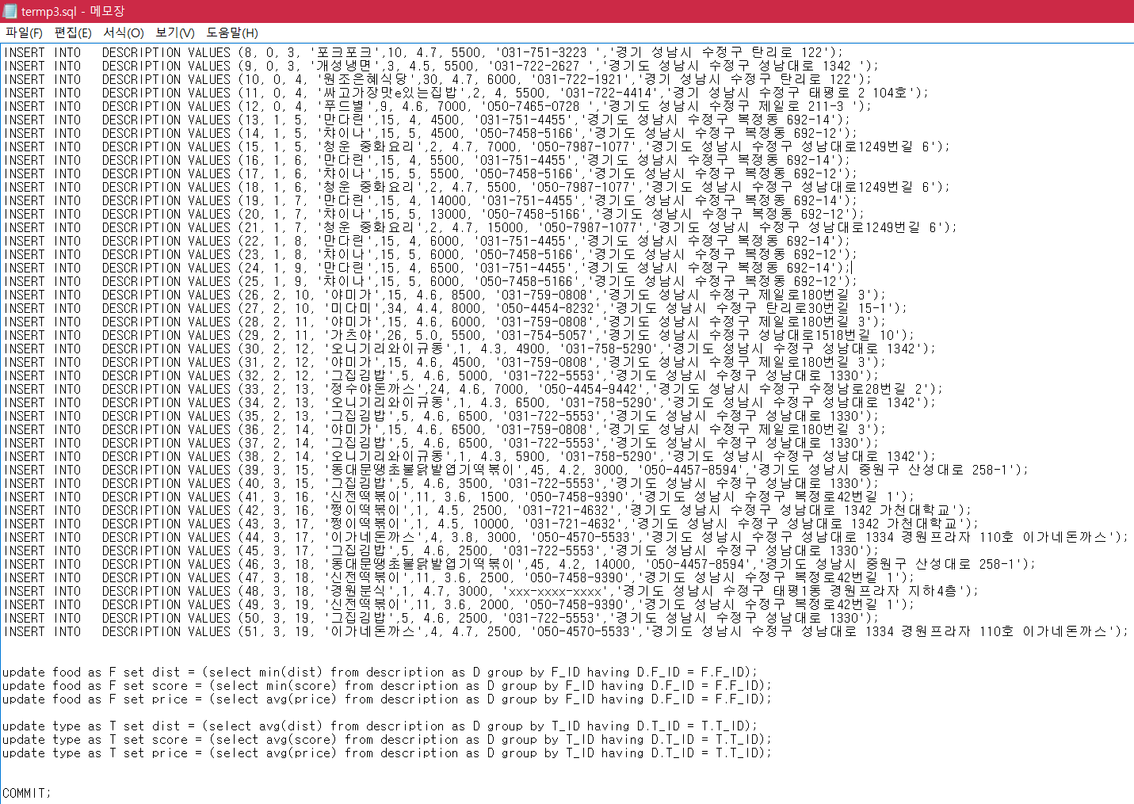

Slide 9






Hardship
Difficulty
Connecting
Code
STUDY !
Explain
own’s code
And Feedback
Unused
Technology

Slide 10

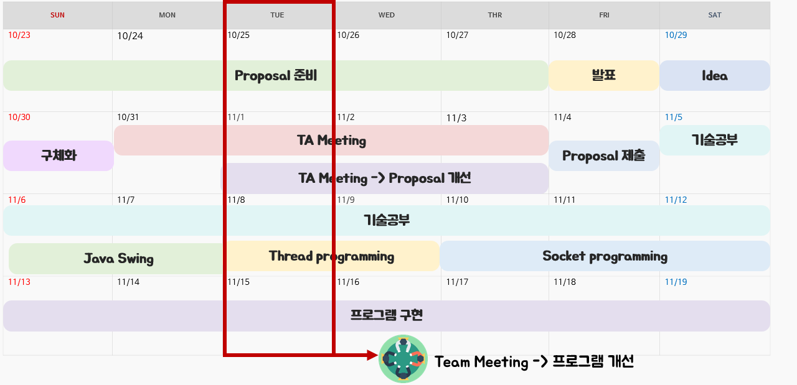
Finally progress

Slide 11

Finally progress

Slide 12
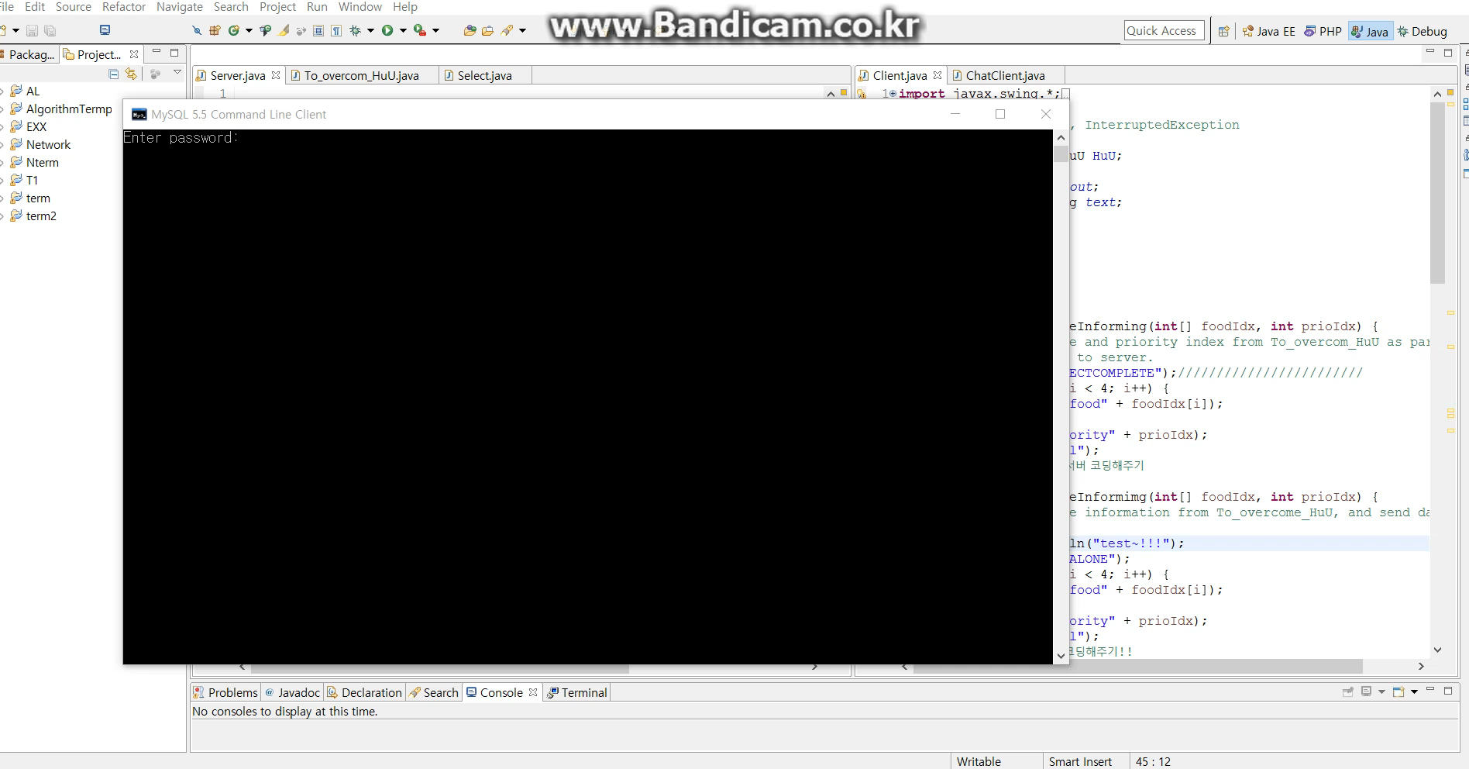

Slide 13
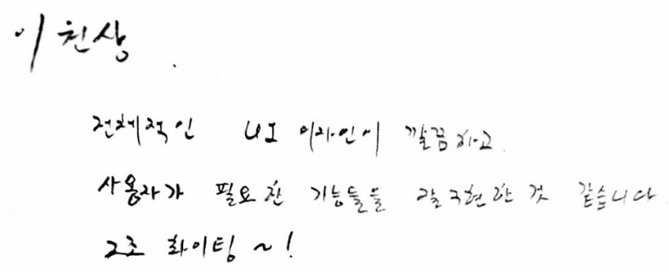

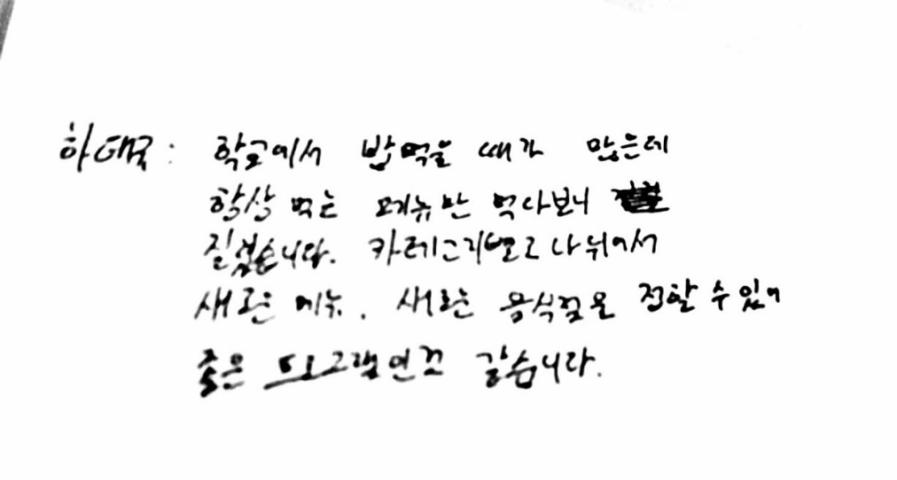
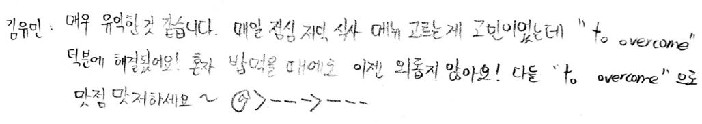

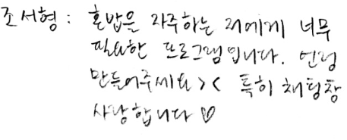
Review

Slide 14



Roles of each member
Member | Role allocation
H : 한다혜 | Chat program manager & Image design
u : 유수화 | Database linkage & Code design
U : 유가은 | GUI Implementation & Image design

Slide 15
Member information
H
한다혜
학번: 201533676
Email: handahye2@naver.com
u
유수화
학번: 201533654
Email: usuhwa2@gmail.cm
U
유가은
학번: 201431118
Email: yge3075@naver.com
GitHub address: https://github.com/Ga-ni/HuU.git

Slide 16
Thank you

